Slide 1
Python - Operators
Premanand S

Slide 2
Basic terminologies
Operand
Operator
Output of the operation / solutions

Slide 3
Operators
Arithmetic operators
Comparison operators
Logical operators
Bitwise operators
Assignment operators
Identity operators
Membership operators

Slide 4
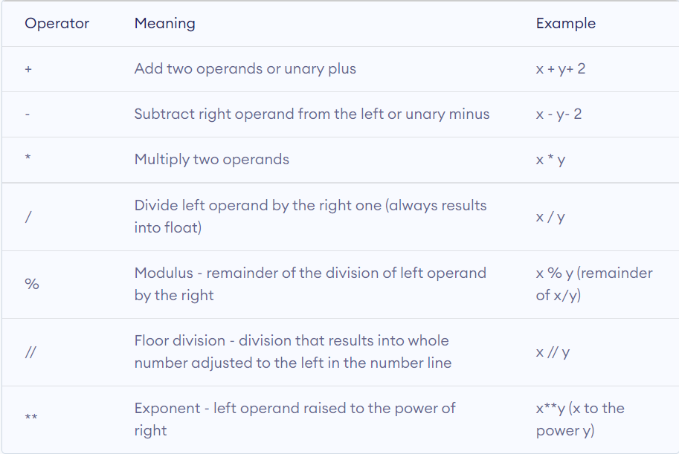
Arithmetic Operators

Slide 5
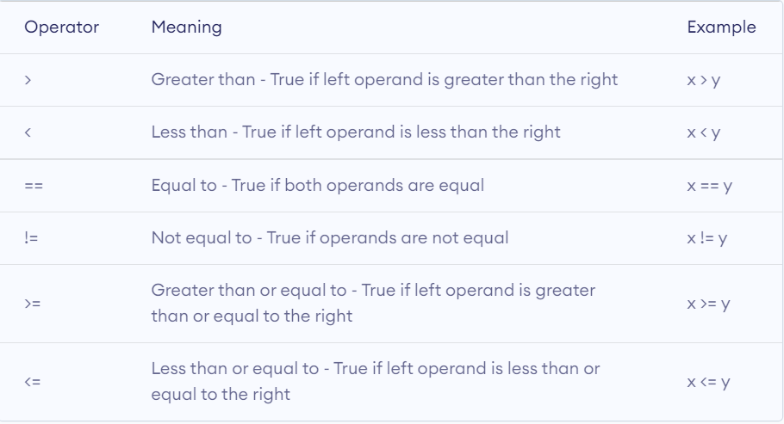
Comparative operators

Slide 6
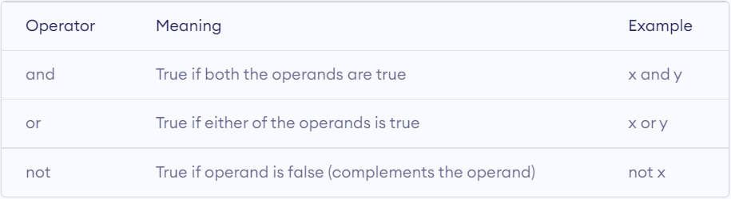
Logical operators

Slide 7
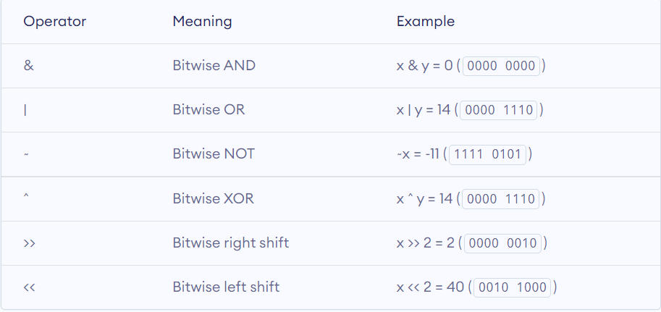
Bitwise operator

Slide 8
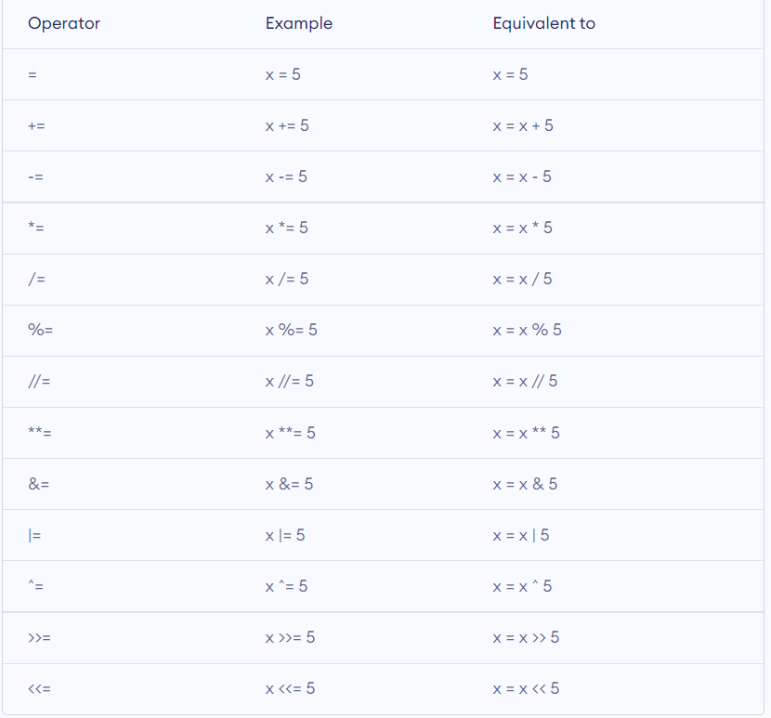
Assignment operator

Slide 9
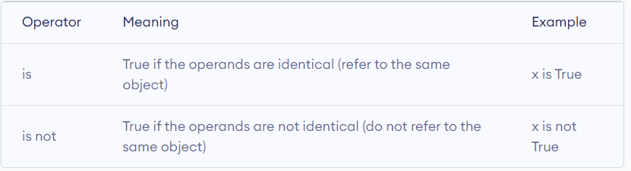
Identity operator

Slide 10
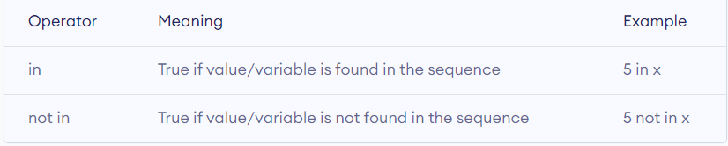
Membership operator

Slide 11
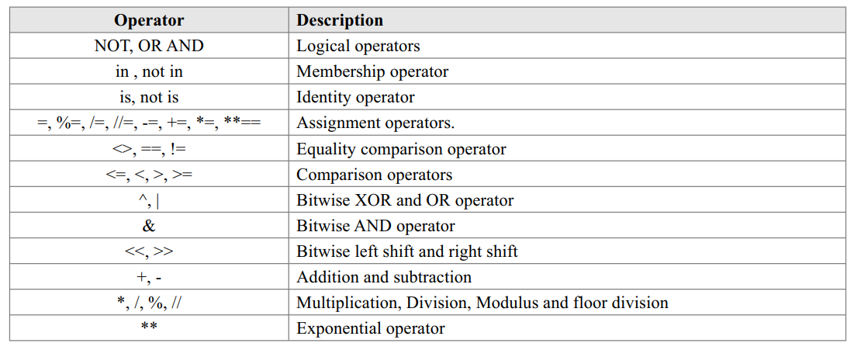
Precedence of Operators

Slide 12
Order of Evaluation
When we string operators together - Python must know which one to do first
This is called “operator precedence”
Which operator “takes precedence” over the others?
x = 1 + 2 * 3 - 4 / 5 ** 6

Slide 13
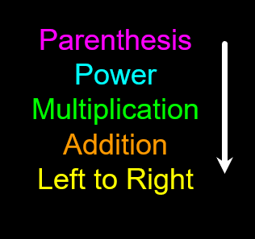
Operator Precedence Rules
Highest precedence rule to lowest precedence rule:
  Parentheses are always respected
  Exponentiation (raise to a power)
  Multiplication, Division, and Remainder
  Addition and Subtraction
  Left to right

Slide 14
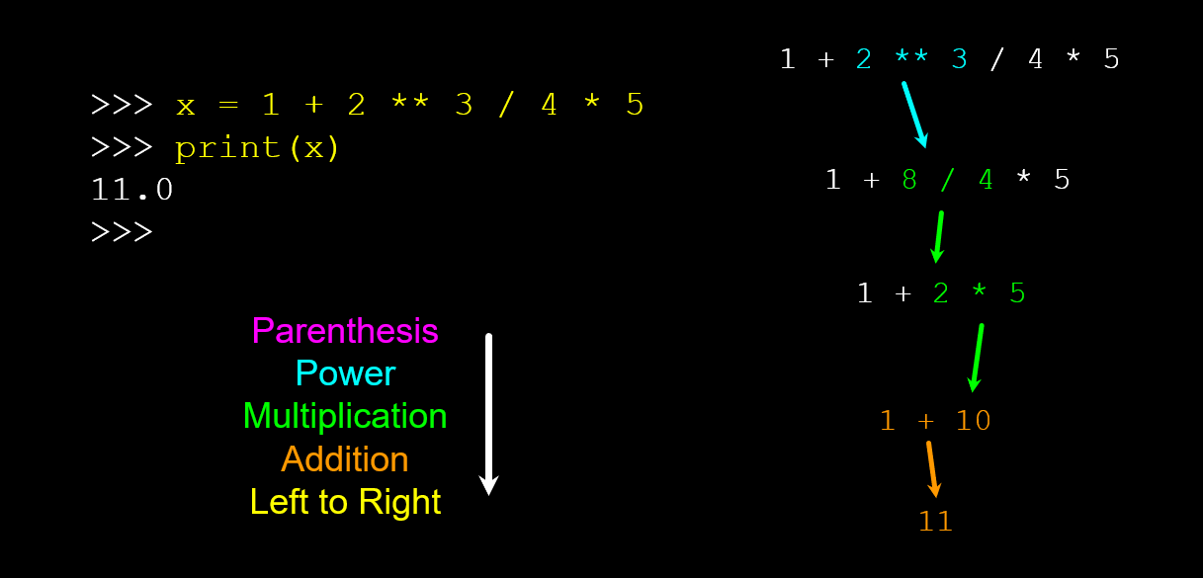
Example

Slide 15
Ternary Operator
Provides short and concise way to write the conditional statements and allows to evaluate and test the condition in a single line of code
Ex: true_value if_condition else false_value

Slide 16
Expressions
Expression = Operators + Operand (gives some value)

Slide 17
Different expressions
Constant expression
Arithmetic expression
Integral expression
Floating expression
Relational expression
Logical expression
Bitwise expression
Combinational expression

Slide 18
Revision
Calculate Body Mass Index Calculator
Create a program using maths and f-strings that tells us how many days, months, years, we have left if we live until 100 years old.
Calculate tip calculator

